Slide 1


San Luis Valley
Community Health Survey
Results for the Top Three Community-Identified Priority Areas
Jini Puma & Sharon Scarbro
Rocky Mountain Prevention Research Center
and Colorado Clinical Translational Sciences Institute
Sjsssjini

Slide 2
Presentation Topics
3 Health Priorities
  Who are the residents with poor mental and physical health?
  Who are the residents who do not engage with the health care system?....What are their “profiles”?
  Who are the residents with diabetes?...What are their “profiles”?

Slide 3

  Who Are the Residents with Poor Mental and Physical Health?
Church of the Stations of the Cross, San Luis

Slide 4
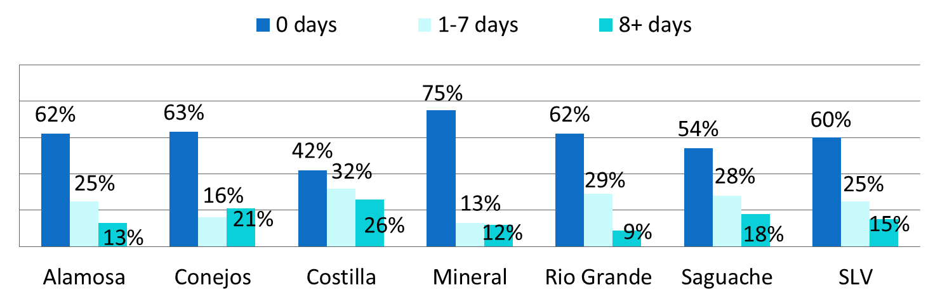
How many days in the past 30 days was your physical health not good?
Although a majority of SLV respondents had zero days on which their health was not good in the last month, responses varied widely from county to county; over a fourth of Costilla County respondents claimed 8+ days of “not good” health.
Notes:
S2Q2

Slide 5
What is Associated with Poor Physical Health?
Increased number of poor physical health days is associated with:
  Increased age
  Low income (<$25,000 vs > $25,000)
  Not having health insurance through work
  Having Medicare or Medicaid
  Having diabetes, arthritis*, or heart disease
  Having a higher number of chronic diseases
  Poor mental health (anxiety* and depression*)
  Lower levels of physical activity*
* Still associated even after controlling for age, income and education

Slide 6
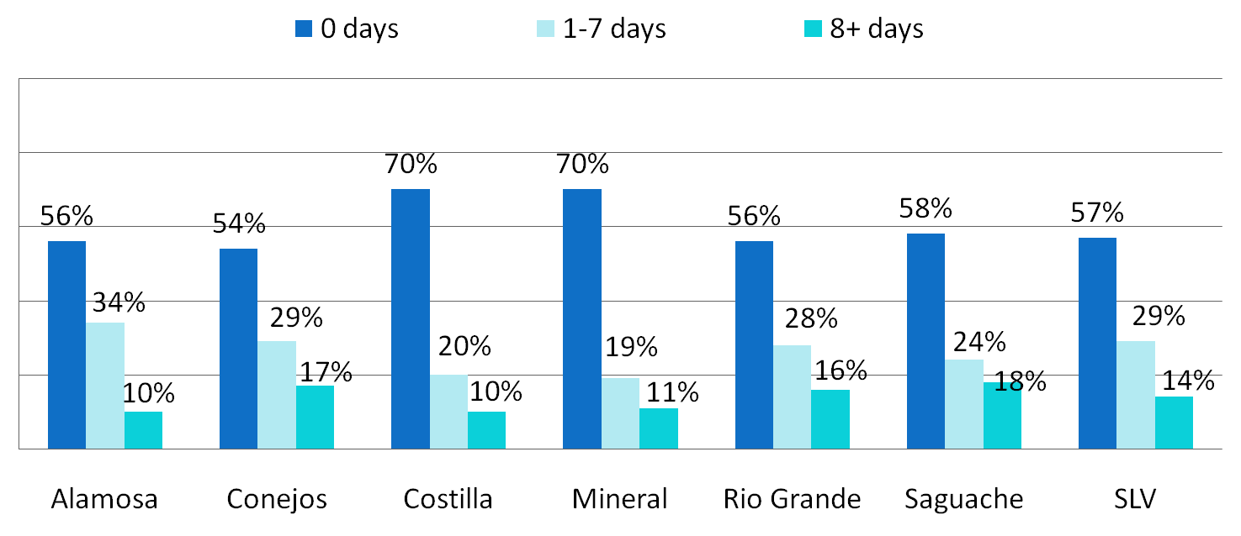
How many days in the past 30 days was your mental health not good?
A third to almost a half of respondents had one or more days in which their mental health was not good in the last month.
Notes:
S2Q3

Slide 7
What is Associated with Mental Health?
Increased number of poor mental health days is associated with:
  Low income (<$25,000 vs > $25,000)
  Having Medicaid
  Having arthritis
  Having anxiety* and depressive* disorder
  Lower levels of physical activity*
* Still associated even after controlling for age, income and education

Slide 8
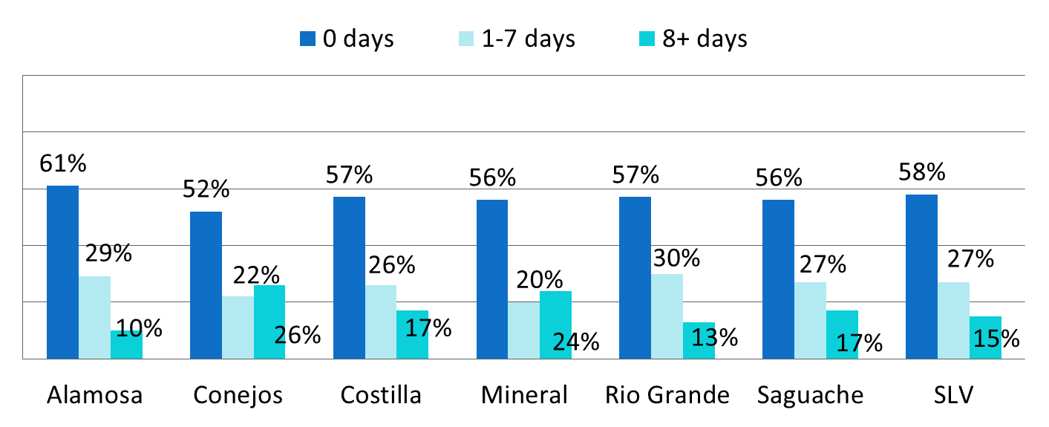
How many days in the past 30 days did your physical or mental health keep you from doing your usual activities?
Over 40% of respondents reported that their mental or physical health kept them from doing activities at least one day in the last month. This equates to lost productivity in the work place and at home.
Notes:
S2Q4

Slide 9
What is Associated with Limited Daily Activity Because of Physical or Mental Health?
Increased number of days that mental or physical health hindered activity is associated with:
  Being male
  Hispanic ethnicity vs non-Hispanic
  Low income (<$25,000 vs > $25,000)
  Less education
  Not having insurance through work
  Having Medicaid or CHP+
* Still associated even after controlling for age, income and education

Slide 10
What is Associated with Limited Daily Activity Because of Physical or Mental Health?
Increased number of days that mental or physical health hindered activity is associated with:
  Having diabetes, arthritis*, heart disease (heart attack, CHD, stroke)
  Having a higher number of chronic diseases
  Having anxiety* and depressive disorder
  Lower levels of physical activity
* Still associated even after controlling for gender, age, income and education

Slide 11
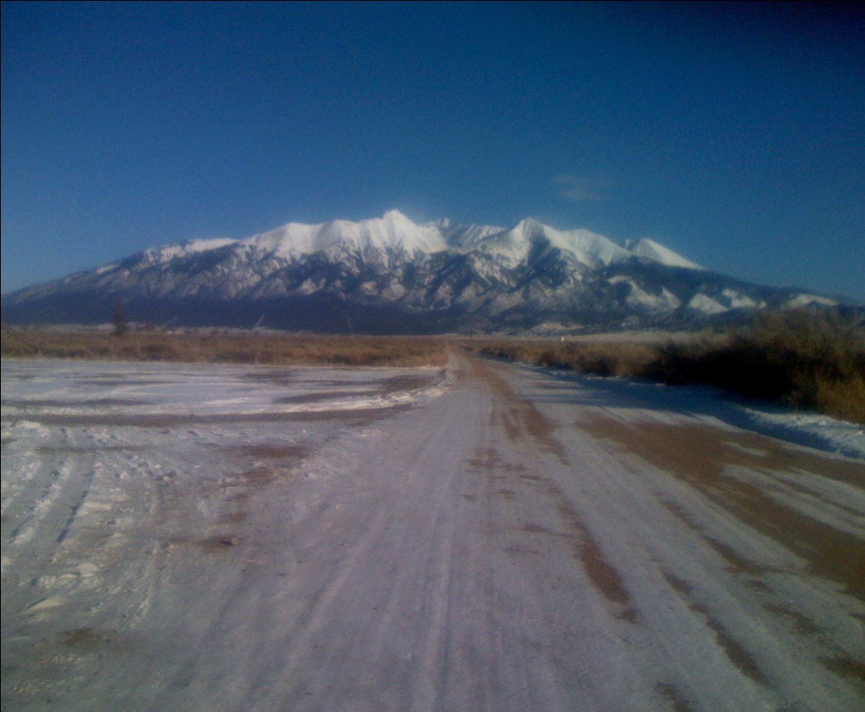
  Who are the residents who do not engage with the health care system? ....What are their “profiles”?

Slide 12
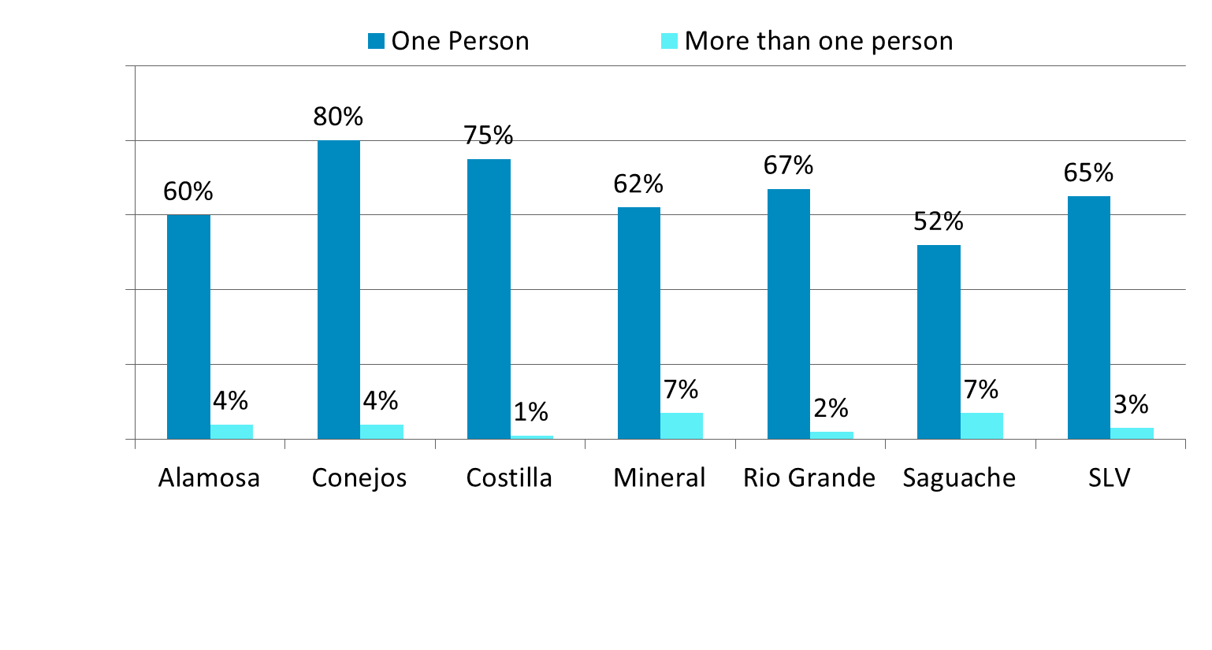
Do you have a person you think of as your personal doctor or health care provider?
Notes:
s3q20

Slide 13
What is Associated with Having No Personal Health Care Provider?
Having no personal health care provider is associated with:
  Age (Younger people more likely)
  Gender (Males more likely)
  Lower income (<$25,000)
Notes:
Age (p=<0.001), gender (p=0.02), Ethnicity (p=0.2) and income (p=0.03) Ethnicity (Hispanics more likely) (p=0.2)

Slide 14
What is Associated with Having No Personal Health Care Provider?
Having no personal health care provider is associated with:
  Not having health care coverage
  Not having diabetes, cancer, arthritis, heart disease (heart attack, coronary heart disease, stroke)
  Having lower numbers of chronic conditions
  Not having anxiety
Notes:
Health care coverage (p=<0.001), dm (p=<0.01), removed obesity (p=0.17), cancer (p=< 0.01), arthritis (p=<0.01), heart disease (p=0.03),
Chronic conditions (p<0.001), Anxiety (p=0.002), removed depression (p=0.09)

Slide 15
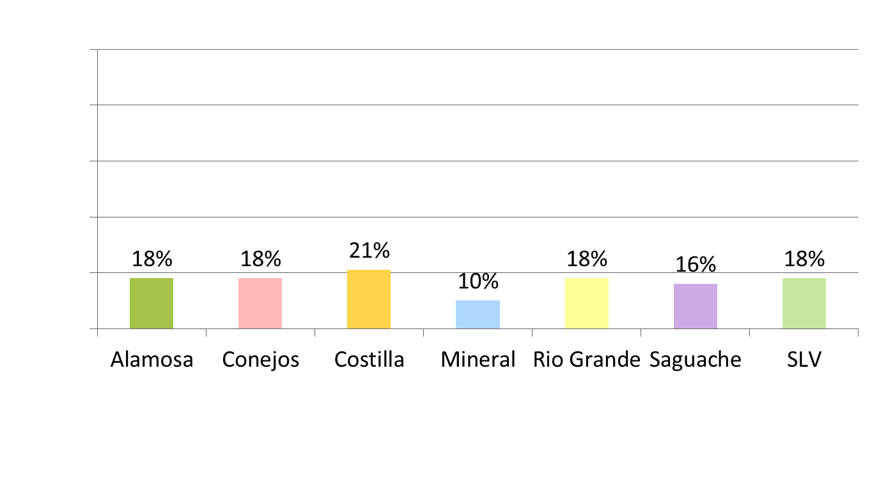
Was there a time in the past 12 months that you needed to see a doctor but could not because of cost?
Notes:
s3q22

Slide 16
What is Associated with Cost Being a Barrier to Seeing a Doctor?
Having cost be a barrier to seeing a doctor in the past 12 months is associated with:
  Age (Younger people more likely)
  Ethnicity (Hispanics more likely)
  Lower income (<$50,000)
  Education (High school and some college)
Notes:
Age (p=<0.001), Ethnicity (p=0.003), income (p=0.004), education (p=0.002) < HS and college are about the same
Education: <HS 14%, HS 19%, some college 25%, college 11%. Makes sense since <HS on Medicare.
Although income doesn’t follow:
Income: <25$ 26%, 25-50$ 15%, 20-75$ 6%, 75+$ 6%

Slide 17
What is Associated with Cost Being a Barrier to Seeing a Doctor?
Having cost be a barrier to seeing a doctor in the past 12 months is associated with:
  Not having health care coverage
  Having anxiety or depressive disorders
Notes:
Health care (p= <0.001) , Anxiety (p=0.0002), depression (p= <.001)

Slide 18
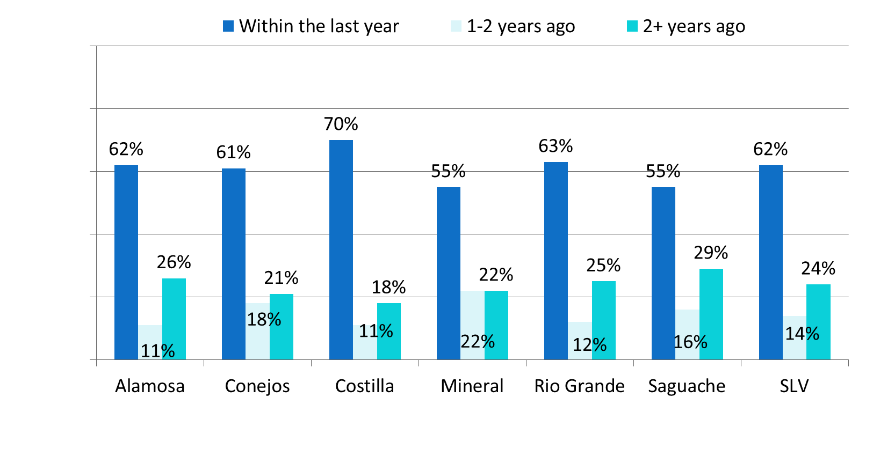
How long since your last routine checkup?
Notes:
s3q23

Slide 19
What is Associated with Going More than 2 Years Since Last Routine Check-Up?
Going more than 2 years since last routine check-up is associated with:
  Age (Older people more likely)
  Gender (Males more likely)
Notes:
Age (p=0.007), gender (p=0.006)

Slide 20
What is Associated with Going More than 2 Years Since Last Routine Check-Up?
Going more than 2 years since last routine check-up is associated with:
  Not having health care coverage
  Not having diabetes, obesity, arthritis, and coronary heart disease
  Having lower numbers of chronic conditions
  Not having anxiety or depressive disorder
Notes:
Health care p=<0.001), DM (p=0.04), obese (p= 0.02), arthritis (p=<0.001), chd (p=<0.001), chronic disease (p=<0.001), anxiety (p=<0.001), depression (p=<0.001)

Slide 21
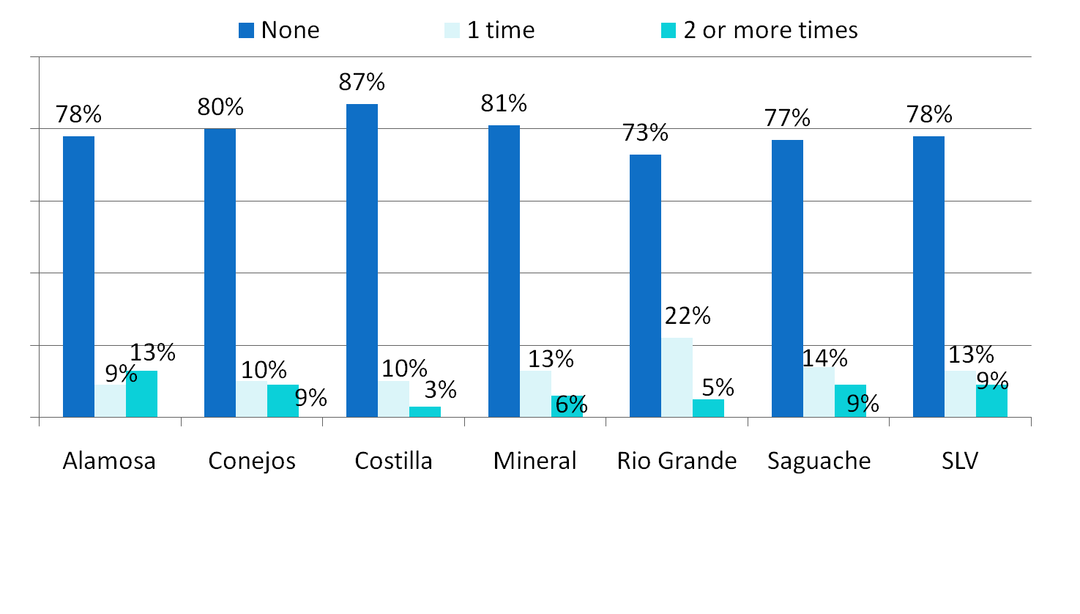
How many times in the past year did you receive care in the Emergency Room?
Notes:
s3q24

Slide 22
What is Associated with Having 2 or More ER Visits in the Past 12 Months?
Having 2 or more ER visits in the past 12 months is associated with:
  Age (Younger people more likely)
  Lower income (<$25,000)
  Less Education (Less than High School)
Notes:
Age (linear p=0.047, Chisq p= 0.03), Income (p=0.02), education (p=0.046)

Slide 23
What is Associated with Having 2 or More ER Visits in the Past 12 Months?
Having 2 or more ER visits in the past 12 months is associated with:
  Having health care coverage
  Having arthritis, asthma, heart disease (heart attack, coronary heart disease, stroke)
  Having higher numbers of chronic conditions
  Having anxiety or depressive disorder
Notes:
Health Care (p=0.03), arthritis (p=0.04), asthma (p=0.003), heart disease (p=0.03), disease count (p=0.001), anxiety (p=0.0003), depression (p=<0.0001)

Slide 24
Correlations between Health Care-Related Variables
 | Personal Provider | Cost a Barrier | Routine Check-Up | ER Visit
Personal Provider | - | -.11** | -.31** | .04
Cost a Barrier |  | - | .12** | .11**
Routine Check-Up |  |  | - | -.11**
ER Visit |  |  |  | -
There is an association between:
  Having no personal provider and having cost be a barrier to seeing a doctor in the past 12 months
  Having no personal provider and having gone longer for a routine check-up (> 2 years)
  Having cost be a barrier to seeing a doctor in the past 12 months and having gone longer for a routine check-up (> 2 years)
  Having cost be a barrier to seeing a doctor in the past 12 months and having more ER visits in the last 12 months.
  Having gone longer for a routine check-up and more ER visits in the last 12 months

Slide 25

  Who are the residents with diabetes? ....What are their “profiles”?

Slide 26
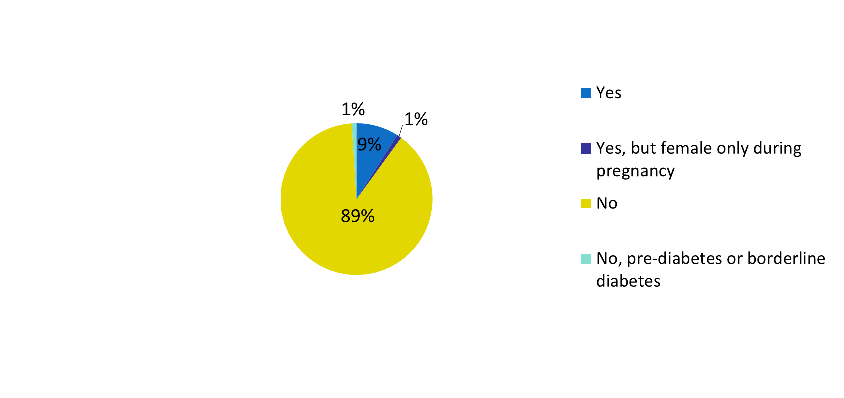
Have you ever been told by a doctor that you have diabetes?
Overall San Luis Valley
9% of Americans 18 years and older had diagnosed diabetes in 2010, according to the Centers for Disease Control and Prevention Behavioral Risk Factor Surveillance System
Notes:
s7q50

Slide 27
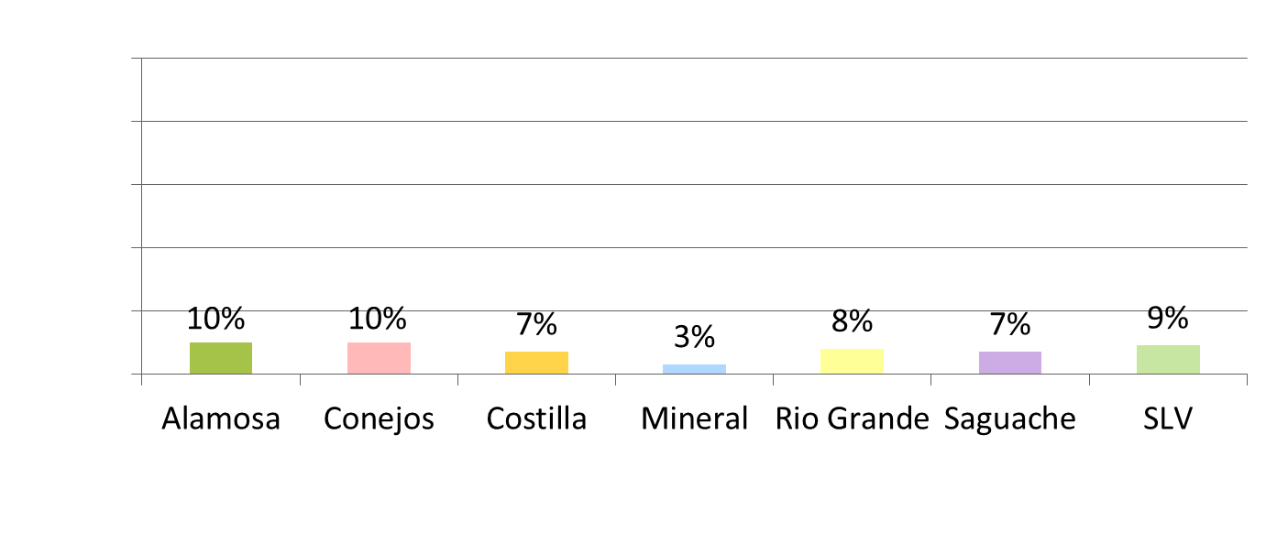
Have you ever been told by a doctor that you have diabetes?
Percent answering yes – adjusted for age*
* Age-adjusted to US 2010 population. Age adjustment is a statistical process applied to prevalence of disease, death, injuries or other health outcomes that allows communities with different age structures to be compared. Age adjustment is a statistical way to remove the effects of having unequal age structures by changing the amount that each age group contributes to the overall prevalence in each community.
Notes:
s7q50

Slide 28
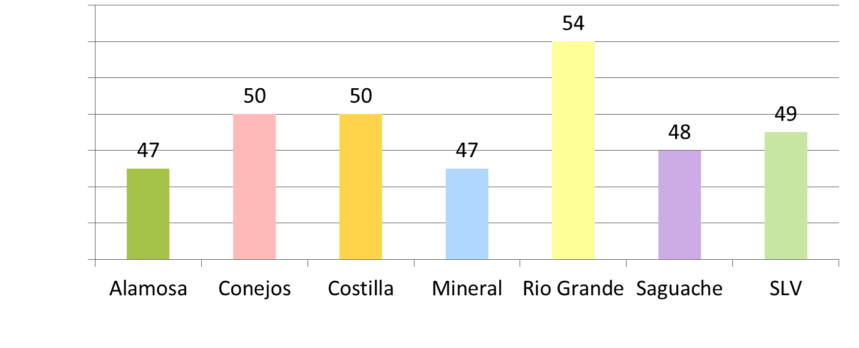
For those with diabetes, how old (in years) were you when you were told you have diabetes? (average ages)
In 2008, the mean age for diagnosis among American adults aged 18-79 was 53 years, according to the CDC.
Notes:
s7q51

Slide 29
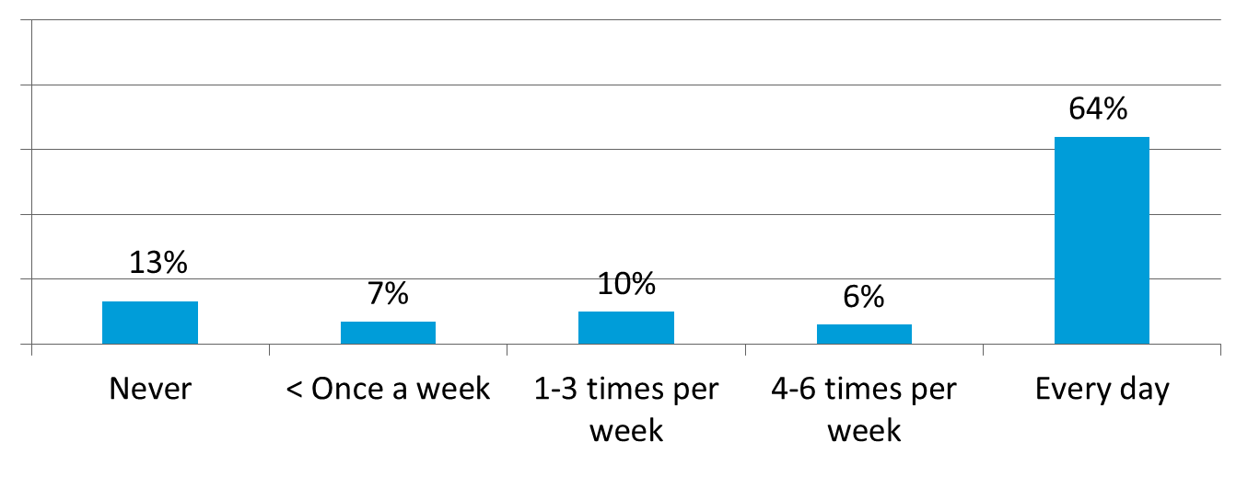
For those with diabetes, about how often do you check your blood for glucose or sugar?
Overall San Luis Valley
Checking glucose levels to see if diet or insulin need adjustment is one way to manage ones diabetes.
Notes:
s7q51

Slide 30
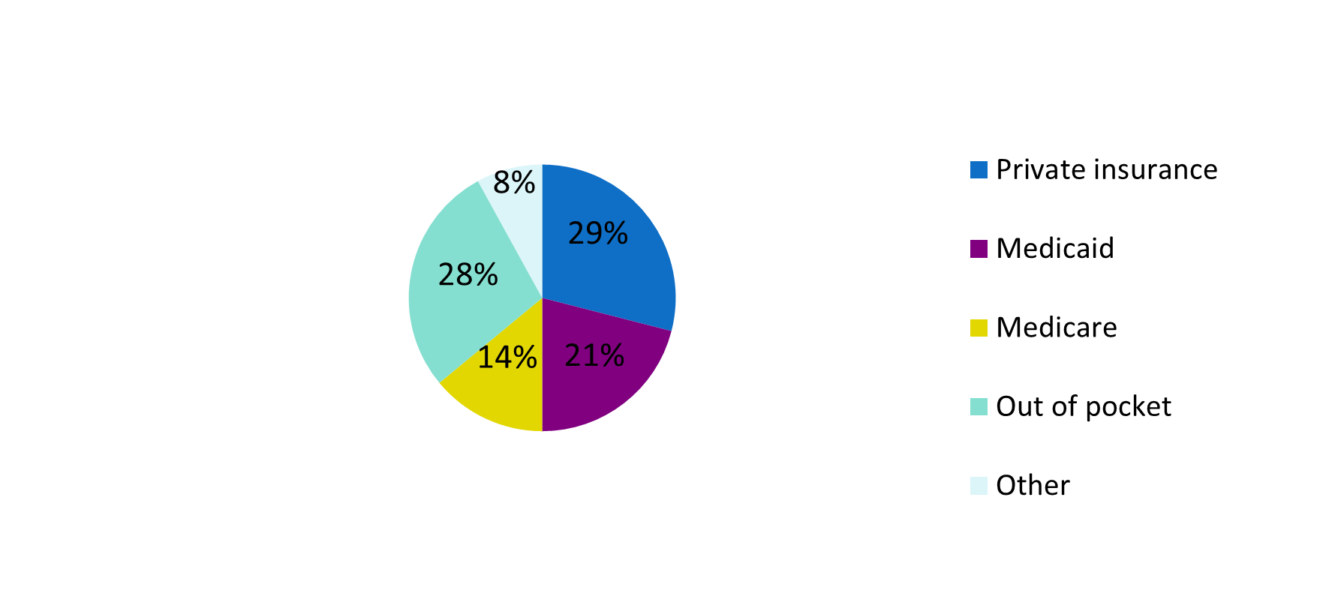
For those with diabetes, how do you pay for checking your blood glucose?
Overall San Luis Valley
Notes:
s7q53

Slide 31
For those with diabetes who do not check their glucose,
Some reasons why not were:
  Diet or weight loss control (n=8)
  Don’t think it’s important/useful (n=4)
  Not recommended by my physician (n=2)
  Only when pregnant (n=2)
  Doctor checks it for me (n=1)
  No reason, I just don’t do it (n=1)

Slide 32
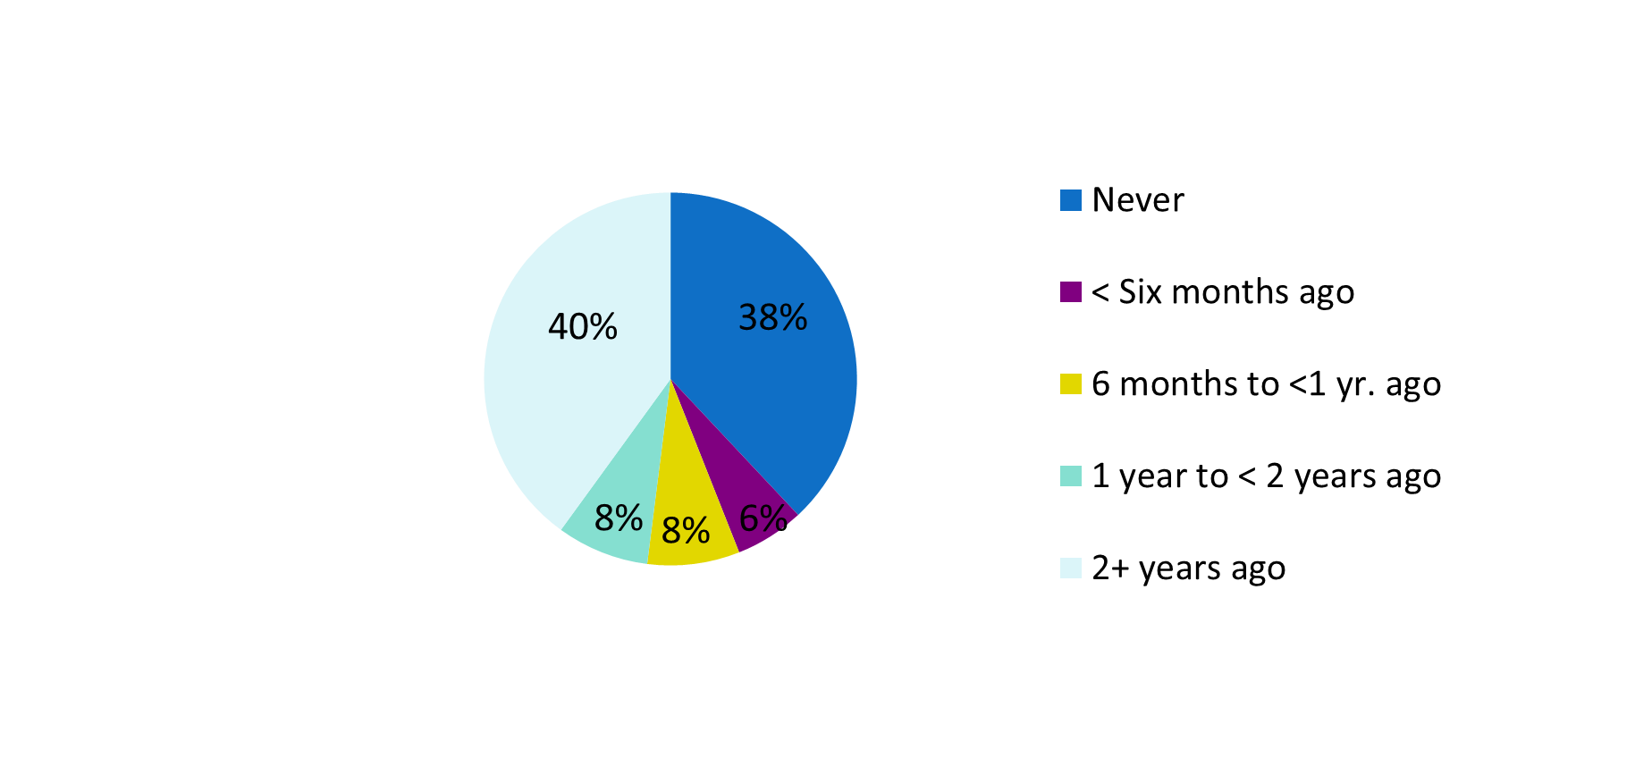
For those with diabetes, when was the last time you took a class in how to manage diabetes yourself?
Overall San Luis Valley
Notes:
s7q55

Slide 33
What is Associated Diabetes?
Diabetes is associated with:
  Increased age
  Hispanic ethnicity (vs non-Hispanic)
  Low income
  Less education
  Having obesity, arthritis, heart disease (heart attack, CHD, stroke), anxiety and depressive disorders
  Not engaging in vigorous physical activity for at least 10 minutes in a week

Slide 34
Food Store Audit Results: Availability of Fresh Fruit
 | Time 1 % (n = 73) 7/2012-10/2012 |  |  |  | Time 2 % (n = 66) 2/2013-5/2013
Fruit | Any | Reference | Organic | Regional | Any | Reference | Organic | Regional
Bananas | 34 | 33 | 10 | 0 | 37 | 34 | 12 | 0
Apples | 37 | 34 | 11 | 14 | 40 | 39 | 15 | 0
Oranges | 27 | 25 | 8 | 0 | 42 | 40 | 14 | 0
Grapes | 26 | 26 | 4 | 0 | 28 | 28 | 2 | 0
Cantaloupe | 21 | 21 | 3 | 4 | 15 | 15 | 0 | 0
Peaches | 23 | 22 | 6 | 8 | 8 | 8 | 0 | 0
Strawberries | 16 | 16 | 6 | 0 | 20 | 20 | 6 | 0
Honeydew | 11 | 11 | 1 | 0 | 17 | 17 | 0 | 0
Watermelon | 22 | 22 | 1 | 6 | 11 | 11 | 0 | 0
Pears | 30 | 29 | 8 | 8 | 26 | 26 | 3 | 0

Slide 35
Food Store Audit Results: Availability of Fresh Vegetables
 | Time 1 % (n = 73) 7/2012-10/2012 |  |  |  | Time 2 % (n = 66) 2/2013-5/2013
Vegetable | Any | Reference | Organic | Local | Any | Reference | Organic | Local
Carrots | 38 | 39 | 12 | 7 | 39 | 37 | 17 | 2
Tomatoes | 40 | 40 | 10 | 7 | 35 | 34 | 6 | 3
Peppers | 32 | 32 | 66 | 3 | 29 | 28 | 5 | 0
Broccoli | 27 | 27 | 10 | 3 | 28 | 28 | 11 | 0
Lettuce | 32 | 32 | 12 | 3 | 28 | 26 | 17 | 2
Corn | 19 | 18 | 1 | 1 | 6 | 6 | 0 | 0
Celery | 27 | 27 | 8 | 0 | 31 | 31 | 9 | 0
Cucumber | 33 | 33 | 6 | 3 | 31 | 31 | 5 | 0
Cabbage | 32 | 30 | 7 | 1 | 34 | 34 | 6 | 0
Cauliflower | 27 | 26 | 7 | 1 | 26 | 26 | 3 | 0
Potatoes | 40 | 40 | 15 | 26 | 37 | 35 | 6 | 17
Spinach | 21 | 21 | 11 | 1 | 22 | 19 | 12 | 0
Chiles | 21 | 21 | 1 | 1 | 15 | 15 | 0 | 0

Slide 36
Acknowledgements
  This project was supported by Award Number UL1RR025780 from the National Center For Research Resources and by Cooperative Agreement Number 5U48DP001938 from the Centers for Disease Control and Prevention.
  Its contents are solely the responsibility of the authors and do not necessarily represent the official views of National Center For Research Resources or the National Institutes of Health or the Centers for Disease Control and Prevention.

Slide 37
Thank you for viewing this presentation!
For more information, please contact:
Dr. Jini Puma
Research Associate – Rocky Mountain Prevention Research Center (Denver)
303-724-4390 jini.puma@ucdenver.edu
Dr. Reginaldo Garcia
San Luis Valley Director – Rocky Mountain Prevention Research Center (Alamosa)
719-589-5801 reginaldo.garcia@ucdenver.edu

